Slide 1

Introduction
Our Point of Sale (POS) web page is an efficient and user-friendly solution for managing transactions at your business. With our system, you can easily process transactions, track inventory, and access customer information.

Slide 2
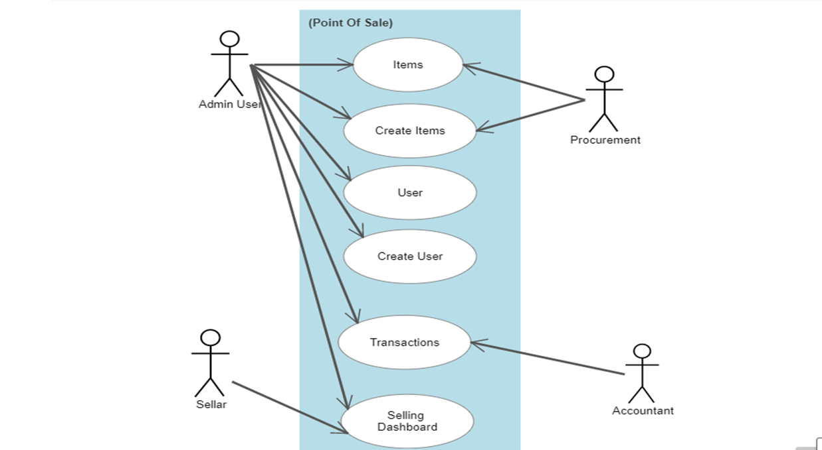
Use-Case Diagram

Slide 3
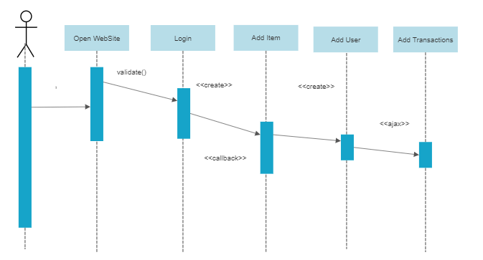
Sequence Diagram

Slide 4
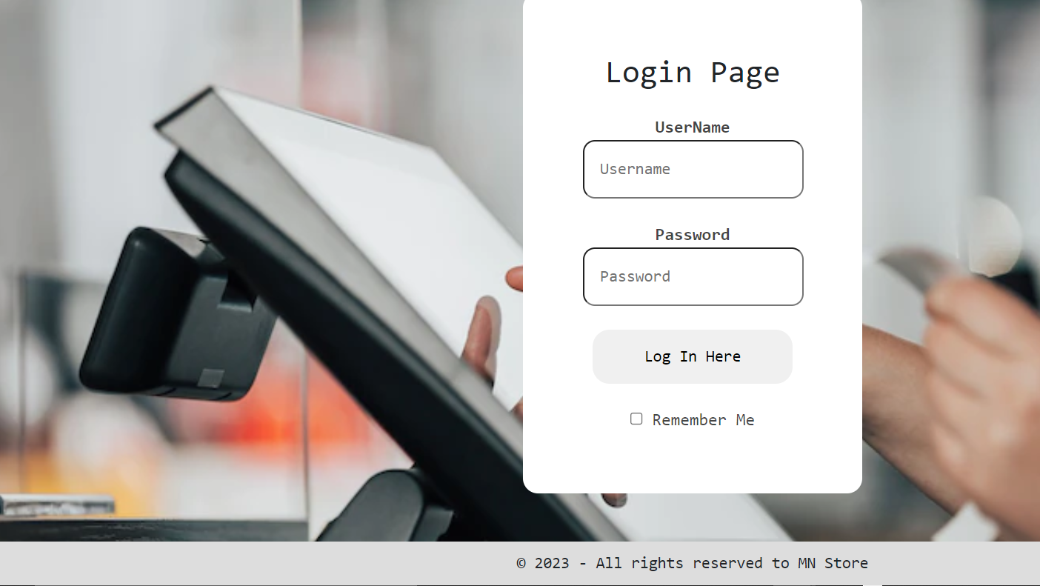
Login Page
This page display the login form to allow the user to enter the site.

Slide 5
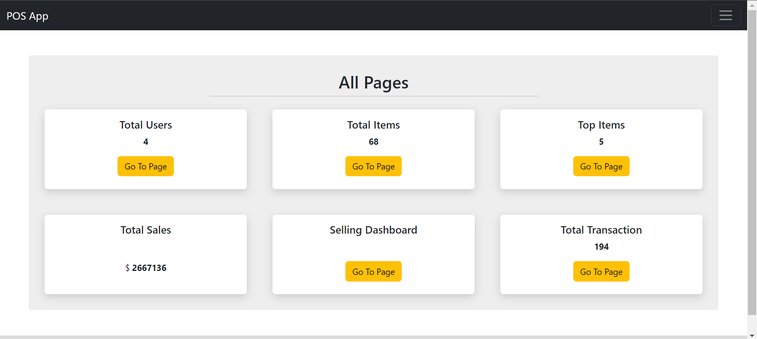
The Dashboard
This show all information about Total Users ,Total Items, Total Transations, Top Items, And Selling Dashboard.

Slide 6
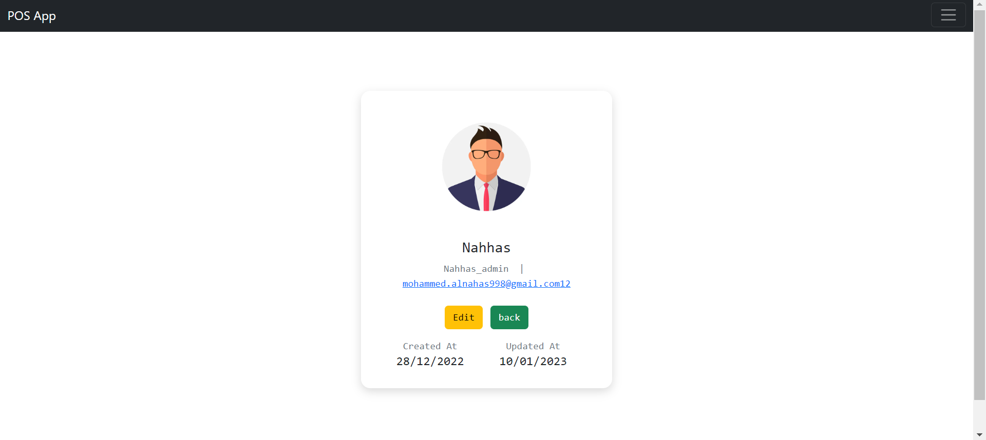
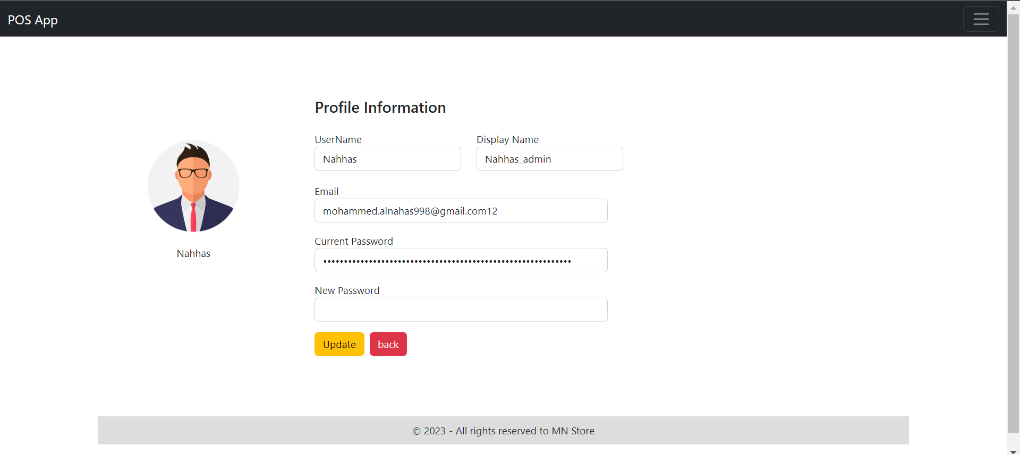
User Profile
This page display the user information who logged in to check his information and edit it.

Slide 7
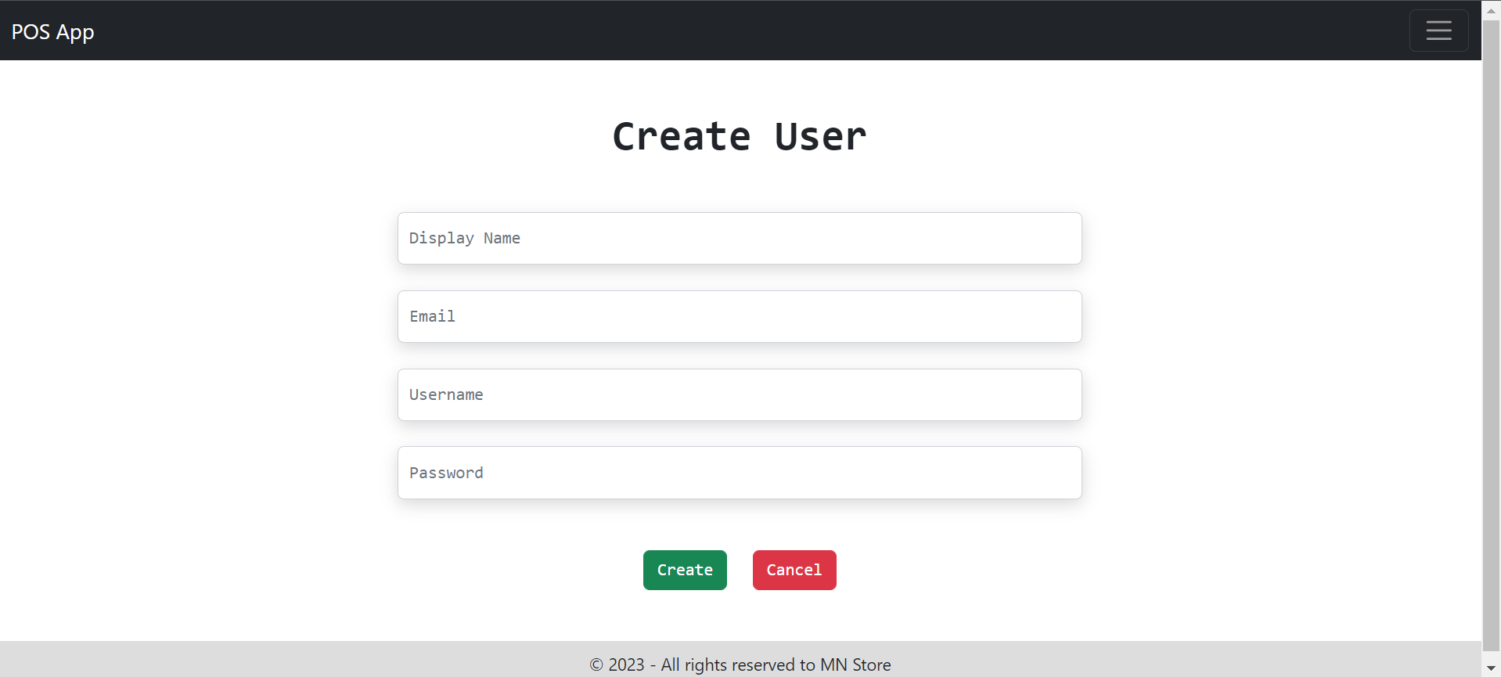
Create User
Only admin user can create new user, when you need to create a user, you must insert all data such as(Display Name, Username, Email, and Password).

Slide 8
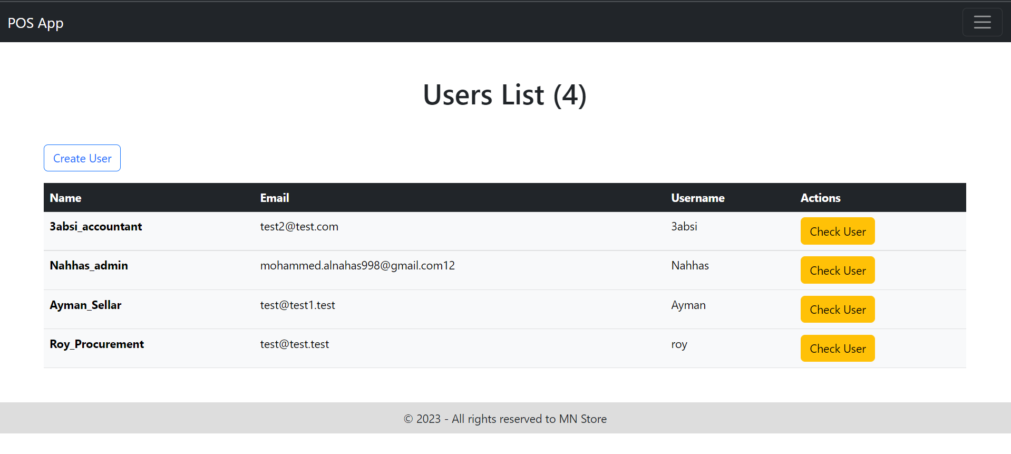
User List
This page to display the user list index page that’s contains the users (Display Name, Email, and username)and button to check user information and to create user.

Slide 9
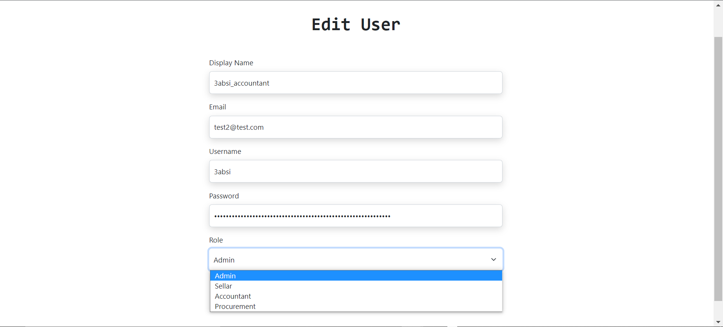
Edit User
Only admin user can edit the role.

Slide 10
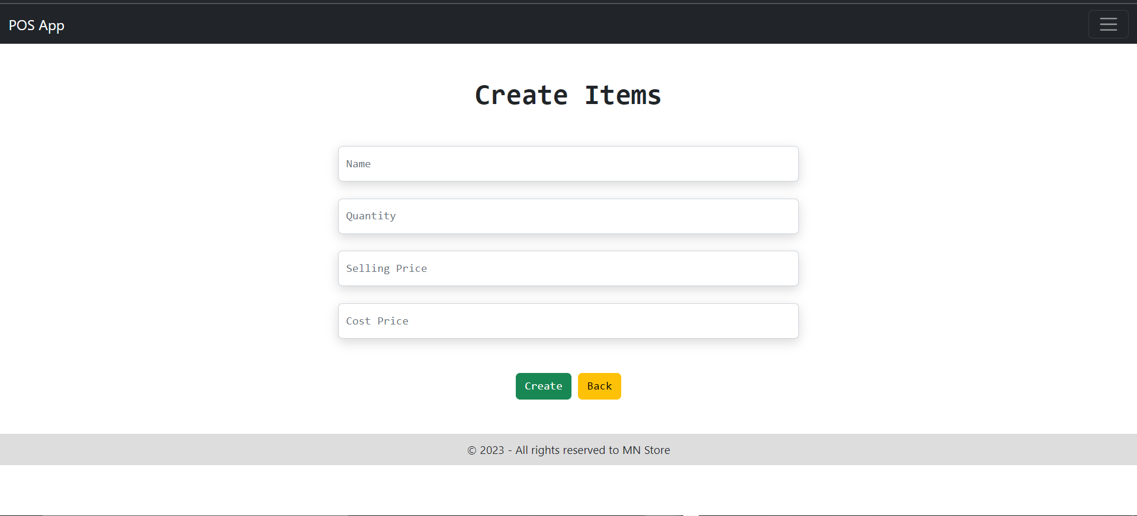
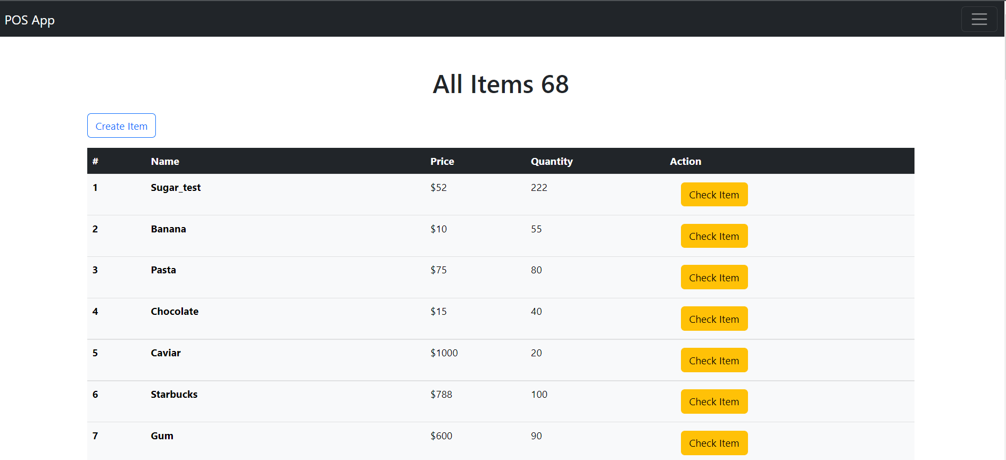
Items and add items
This page to display the items list index page that’s contains the Items (Name, quantity, cost price, and selling price)and button to check items information and to create item.

Slide 11
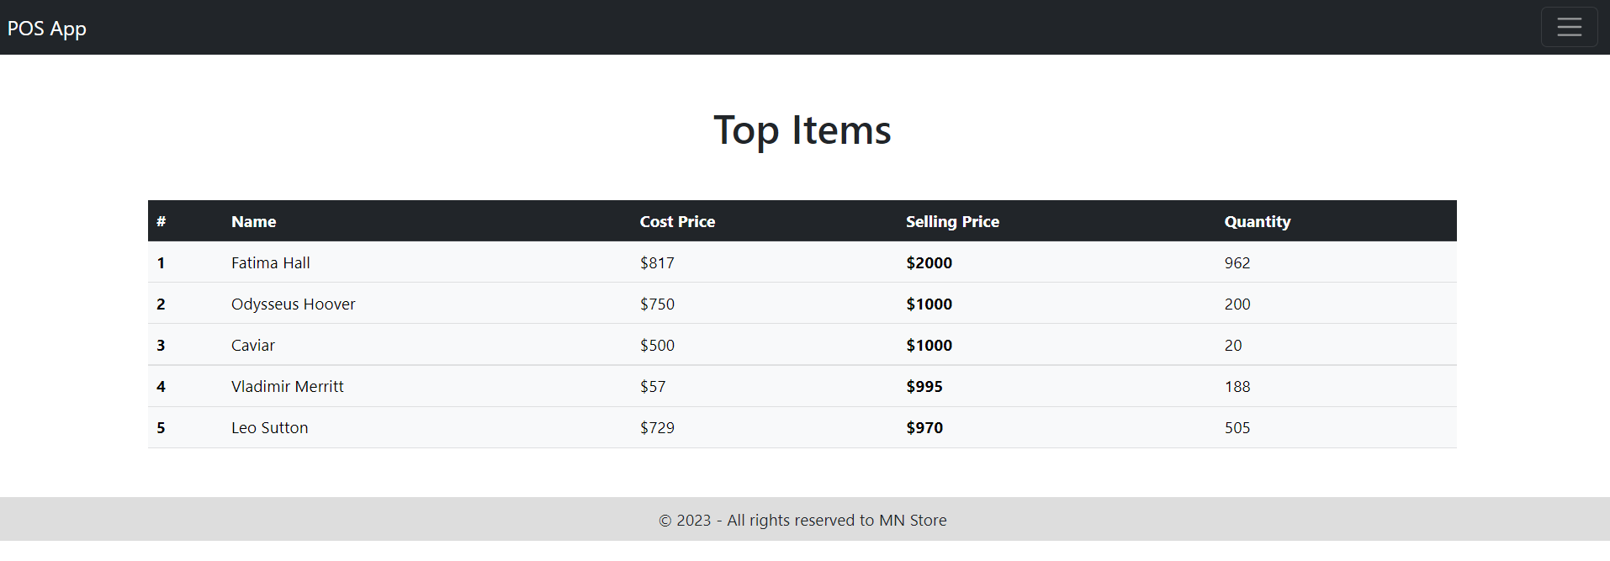
Top Five Items
On this page, the best selling products are displayed based on the selling price.

Slide 12
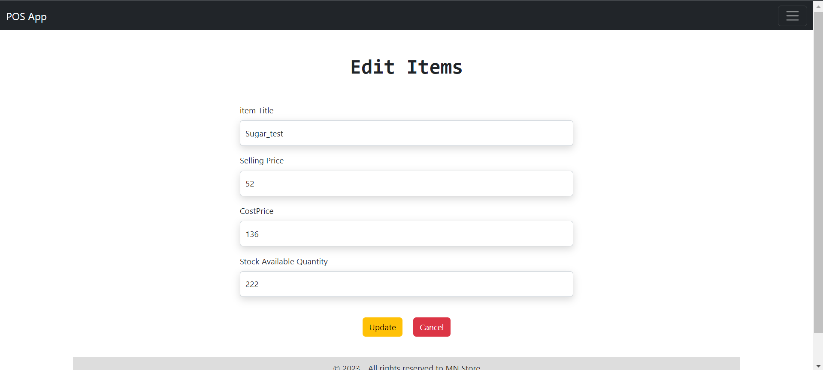
Edit Items
This page to edit items information's and they only allow users to modify based on the permissions granted to them.

Slide 13
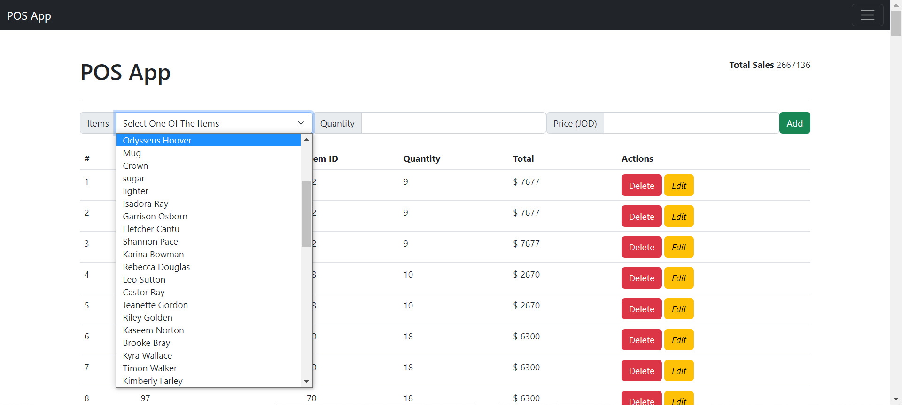
Selling Dashboard
On this page, transactions are made and items are added with the following information (item id, quantity, and the total price).

Slide 14
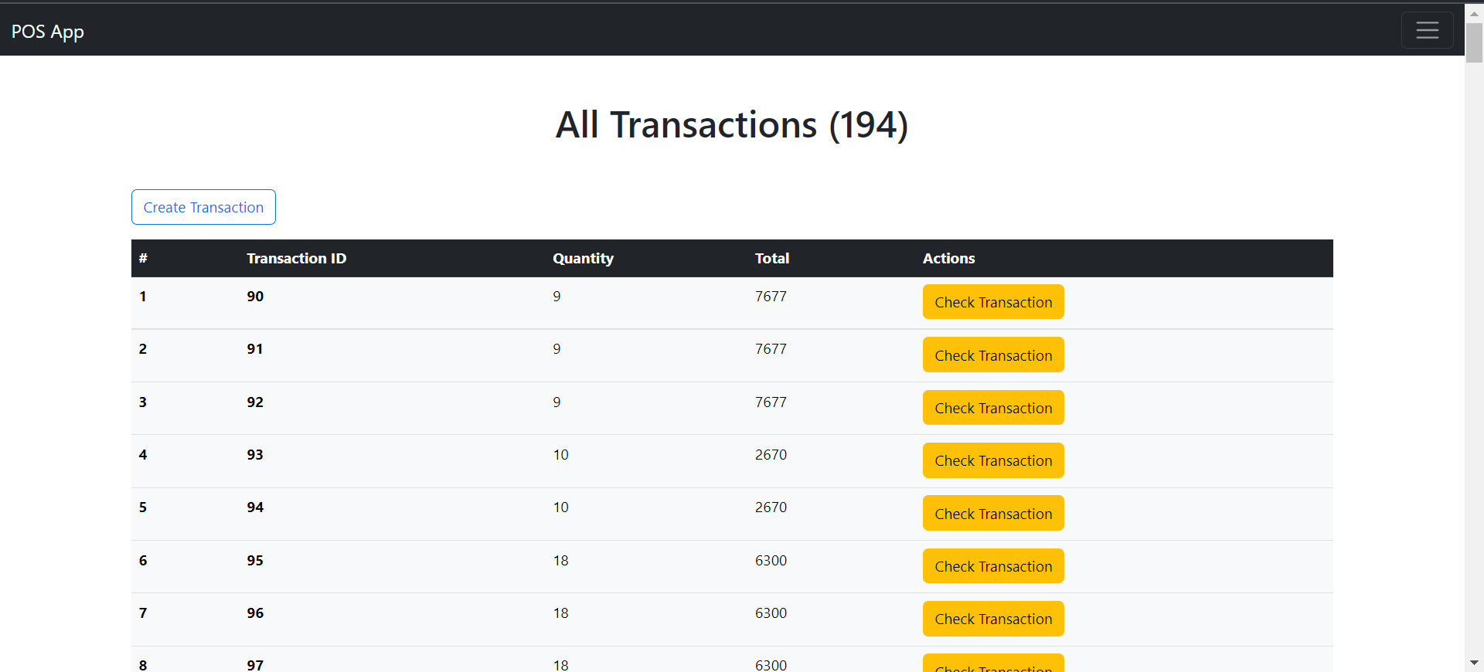
Transactions
This page to display the transactions index page that’s contains the information (item id, transactions id, quantity, total price)and button to check transactions information and to create transactions.

Slide 15

Conclusion
Point-of-Sale App, or POS systems, are crucial for businesses of all types and sizes. They provide a range of benefits, including improved efficiency and accuracy in transactions, streamlined inventory management, and detailed sales reporting.

